Slide 1
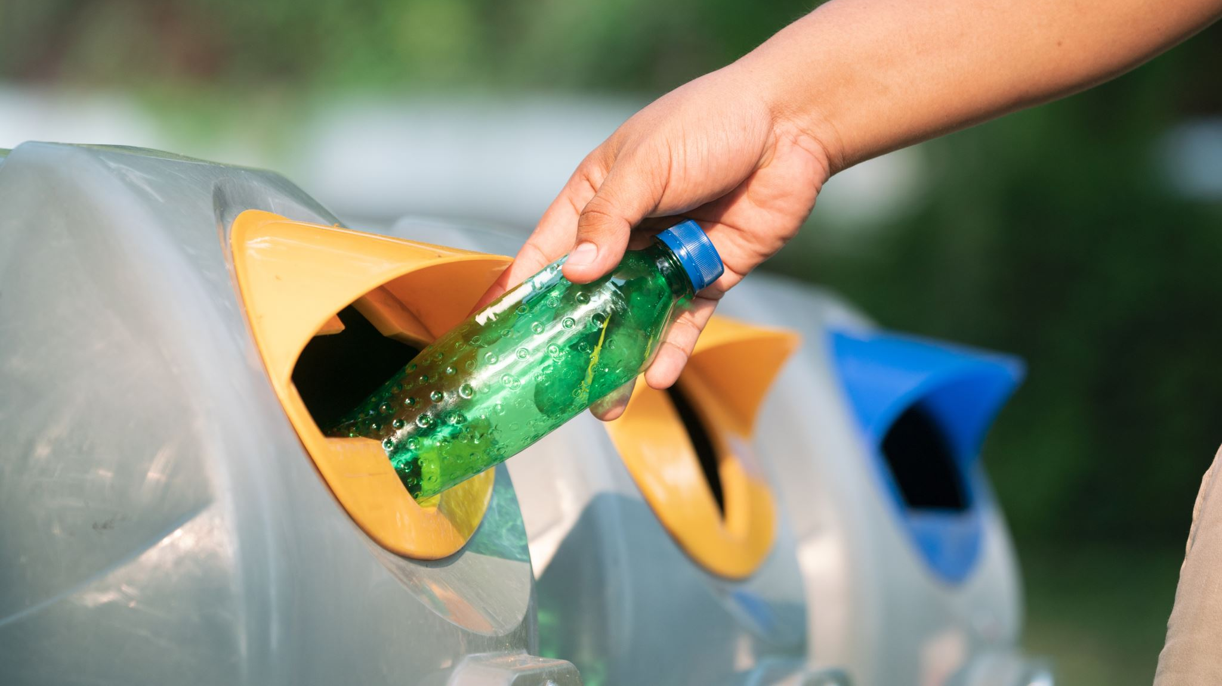
Recycling Project
Aline Ventura
Lili Manzanares

Slide 2
Project
Building a machine learning model to classify different types of recycling materials based on images.
The goal is to train the model on standard images and test it on real-world images to see how well it can identify different categories of materials.

Slide 3
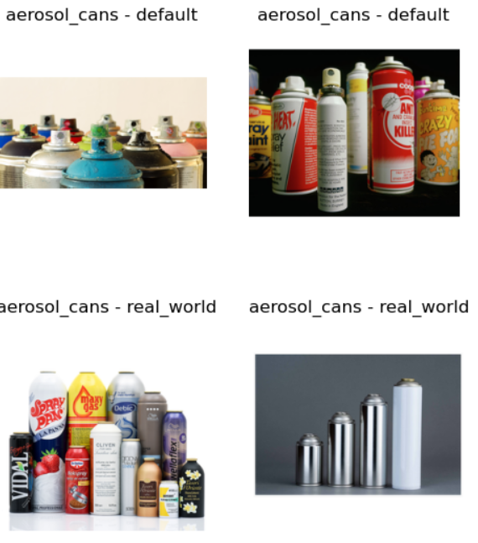
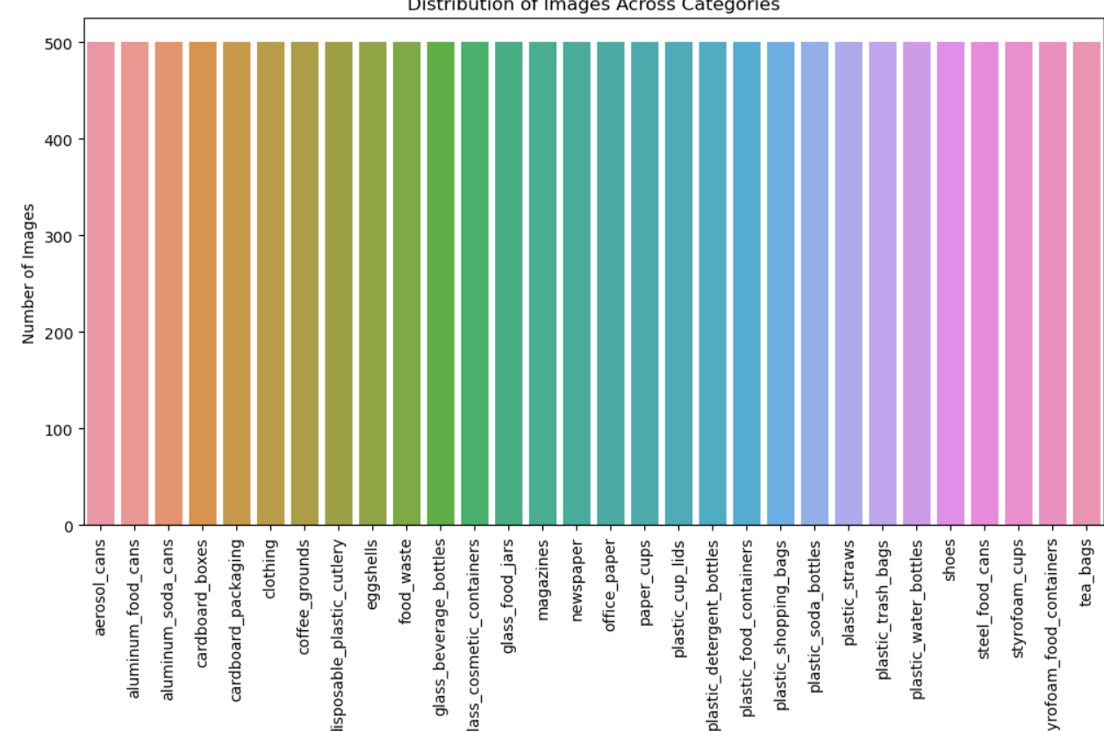
Dataset
30 categories
250 items Default
250 items Real-World

Slide 4
Data Preparation
Image Size Reduction: reducing image size (128x128 pixels) for faster processing;
Image Data Generator: Class to help to automatically adjust and prepare the images for training. It also adds small changes to the images (like flipping and zooming) to help the model learn better.
Data Generators: load the images in batches and prepare them for training and validation.

Slide 5
Model Definition and Training
MobileNetV2: Smart and efficient model. It's good at recognizing images while being fast and light. It balances speed and accuracy
Model Architecture:
Sequential Model: MobileNetV2 base with added layers (GlobalAveragePooling2D, Dense, Dropout)
Compile Model: Adam as Optimizer, Categorical_crossentropy for Loss and Accuracy as Metric
Steps Per Epoch and Validation Steps: for efficient training on batches
Early Stopping: To avoid training for too long and possibly overfitting we stop training when the model's performance stops improving on the test group.

Slide 6
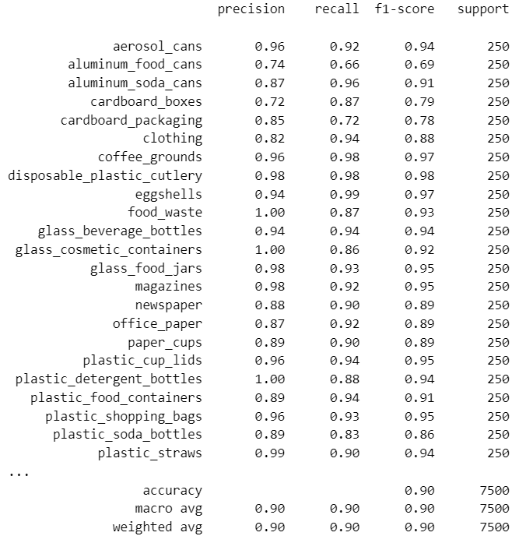
Evaluation

Slide 7
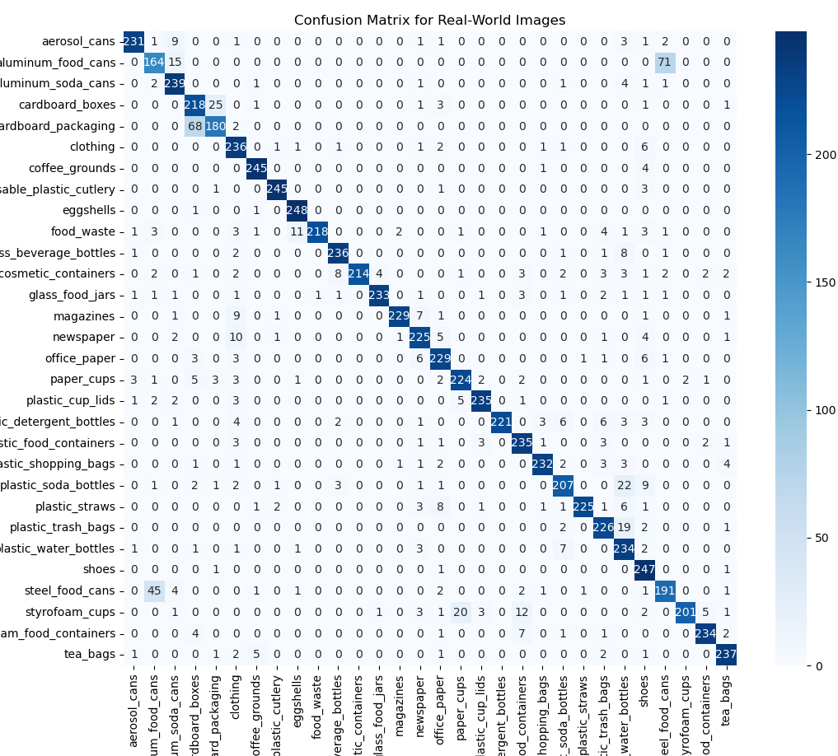
Evaluation

